Slide 1


Movie Scripts
Marshal Will, Mikolaj Wieczorek

Slide 2
Introduction
Motivation: interesting insights of words common to specific movies
- Rarely/Commonly used words
- Clustering of Movies based on words
- Association between certain words
- Frequent Types of Emotions in Specific Movies
- Emotional Variance Over Time in a Movie

Slide 3

Database Source
Source: Internet Movie Script Database (IMSDb)
Pulled Movies based on specific Genre like Horror or Drama
Categories Chosen: Action, Adventure, Comedy, Crime, Drama, Family, Fantasy, Horror, Romance, Sci-Fi, Thriller, and War

Slide 4
Scrapping and Cleaning Processes
Loop had to cycle through each HTML link of IMSDb (10,000+ movies!)
Chose 900 movies and scraped from mentioned genres
Spoken word script clean-up: extensive process
Removing “(CONTINUED)” or “Contd”
Removing descriptive parts of the script
Removing punctuation, etc.

Slide 5
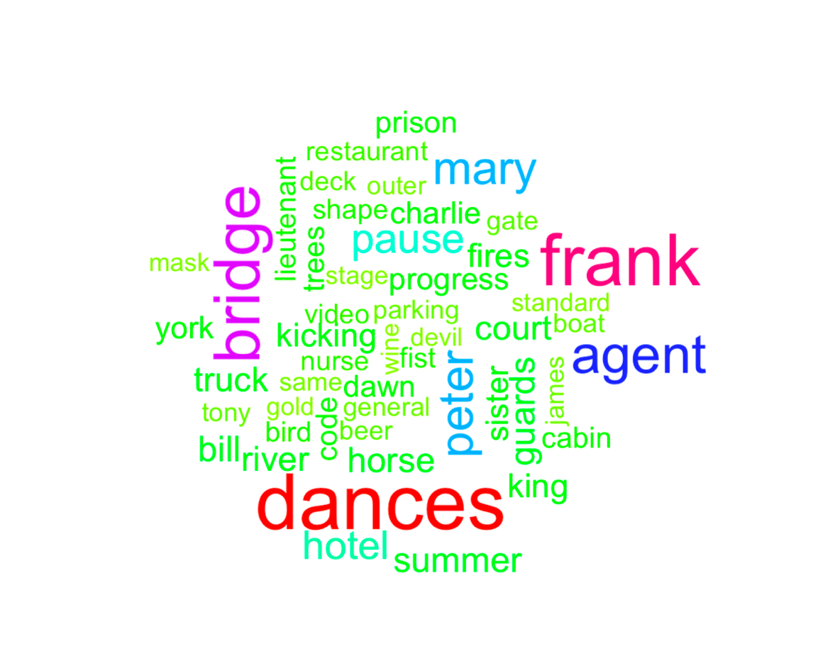
Notes:
Long time to get spoken word script ready so following examples are for 85 movies

Slide 6
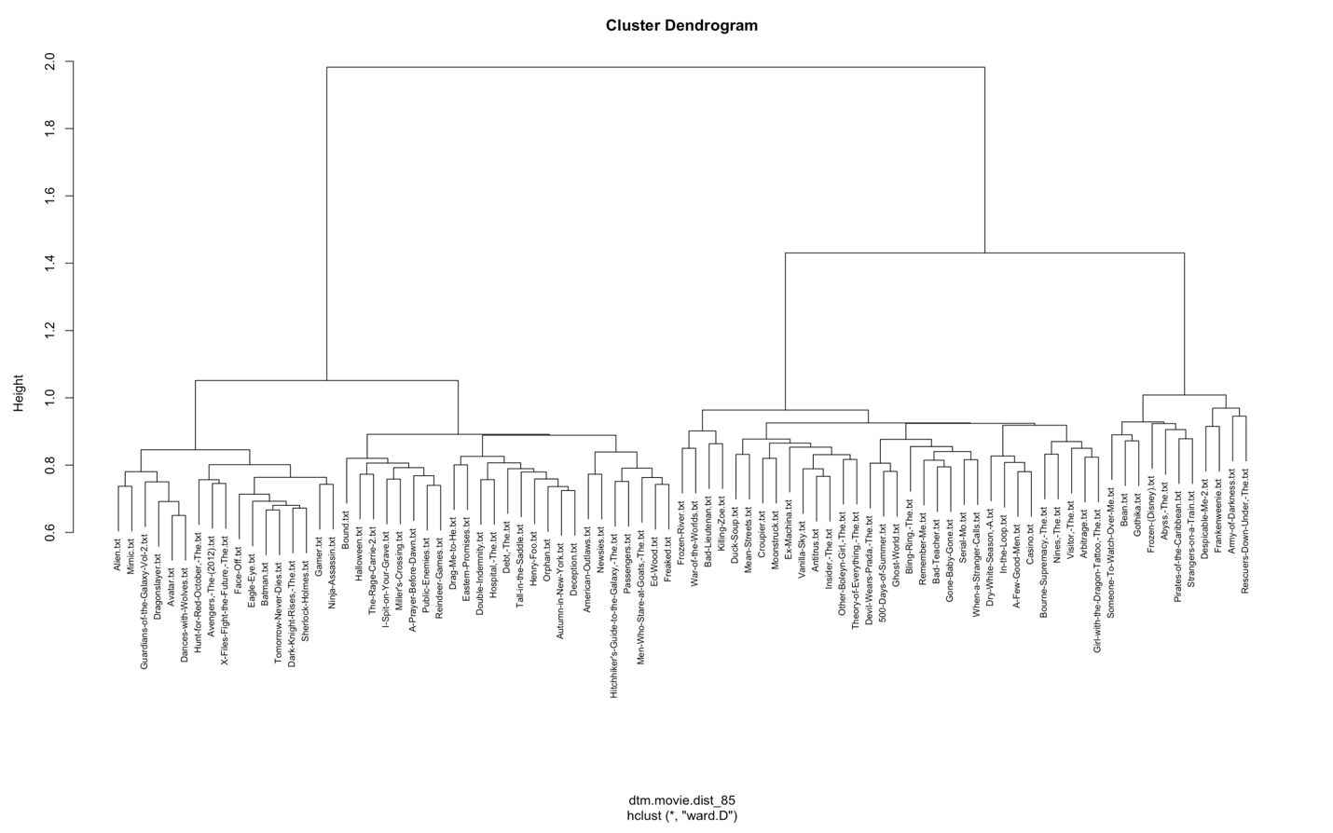
Dendrogram Movie Clusters
Interesting Cluster Disney Movies
-Despicable Me
-Frozen
-Pirates of the Caribbean
Notes:
85 movies by 3182 rows

Slide 7
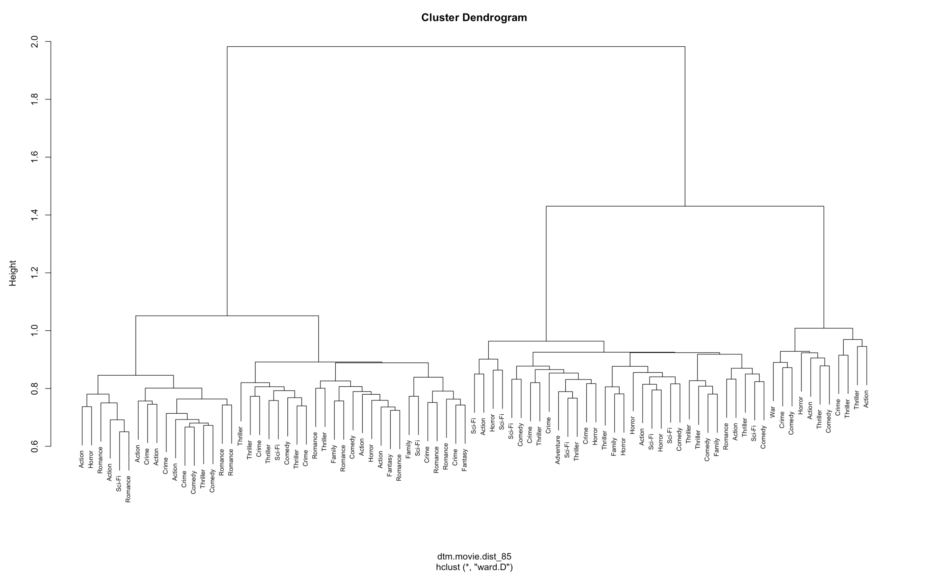

Slide 8
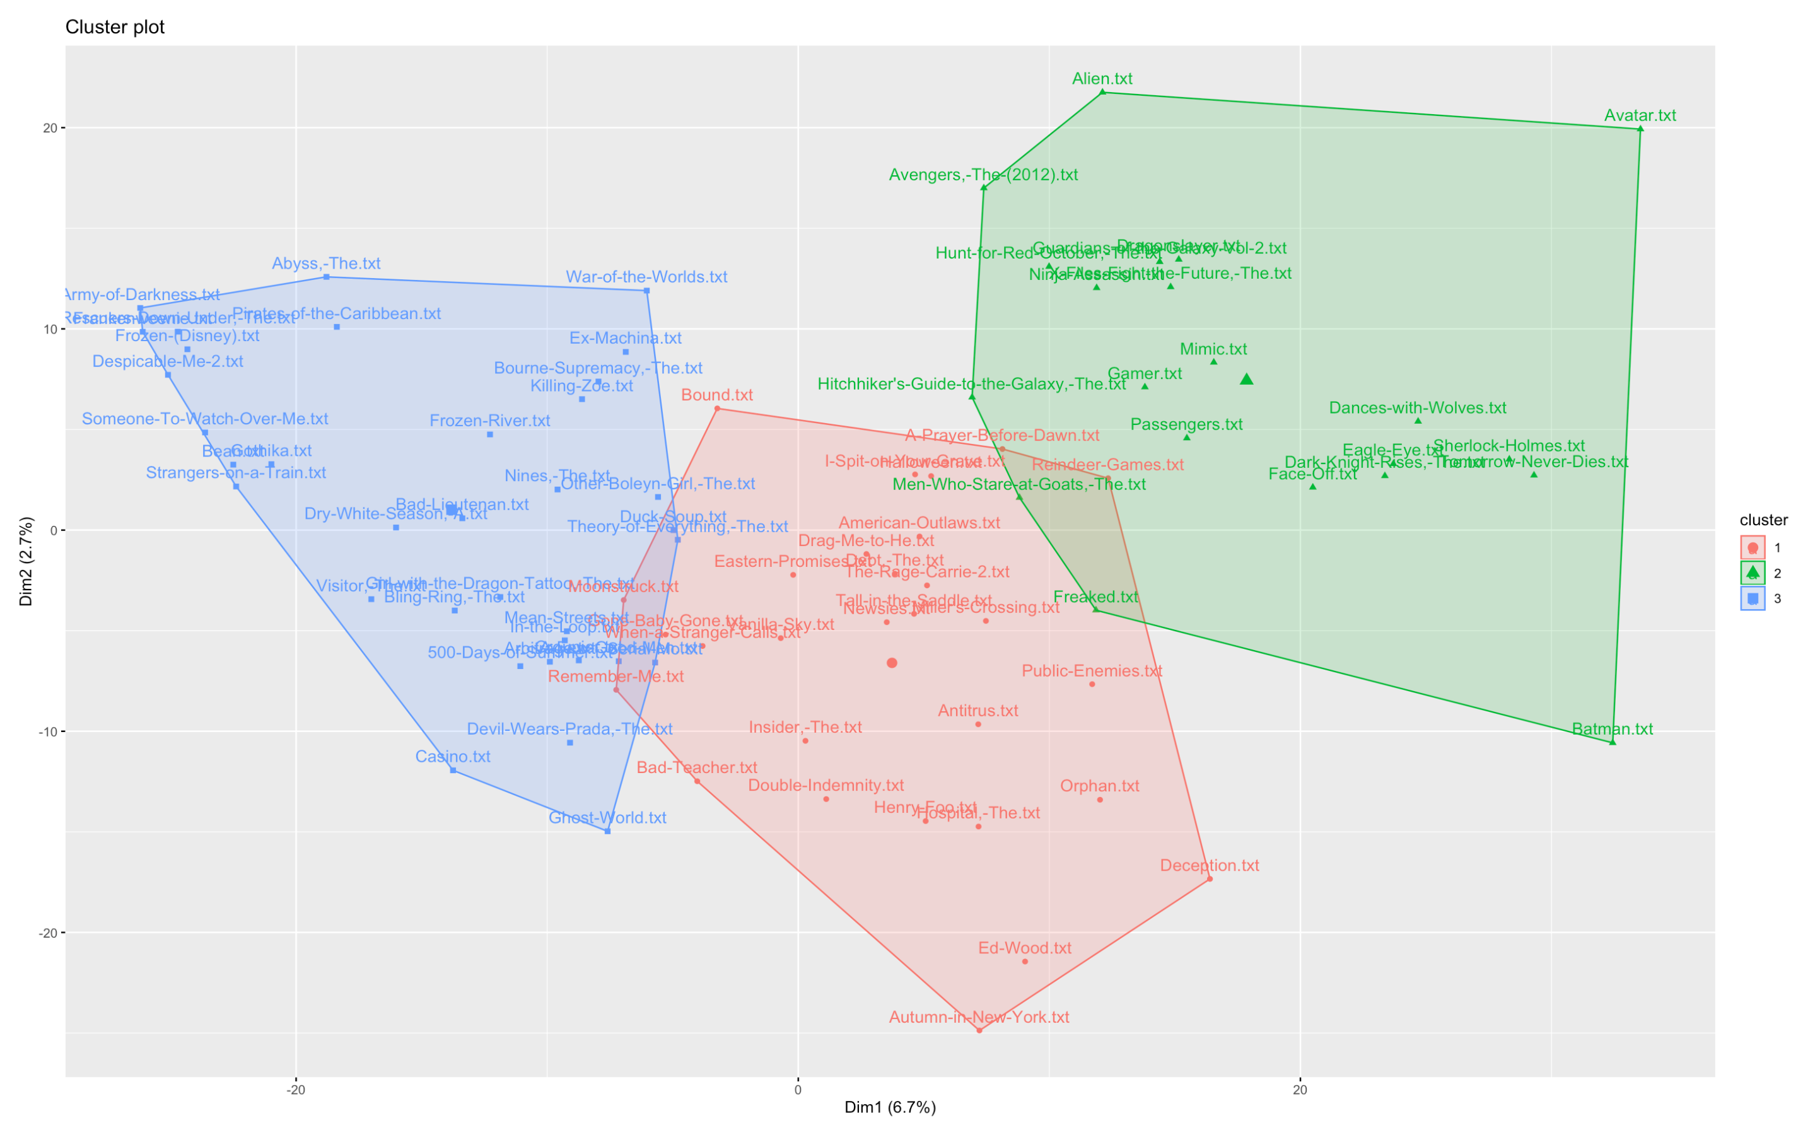
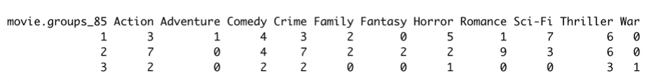
Clustering: K-means

Slide 9
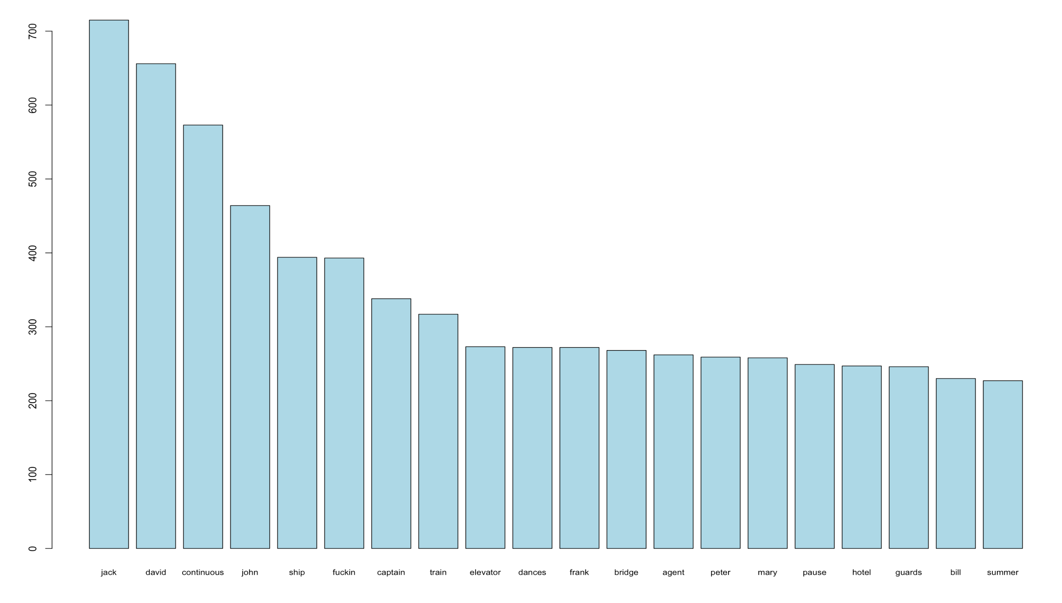
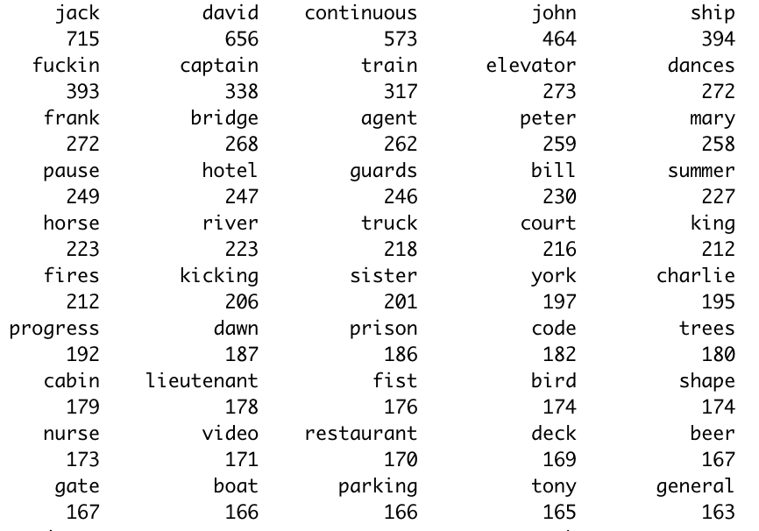
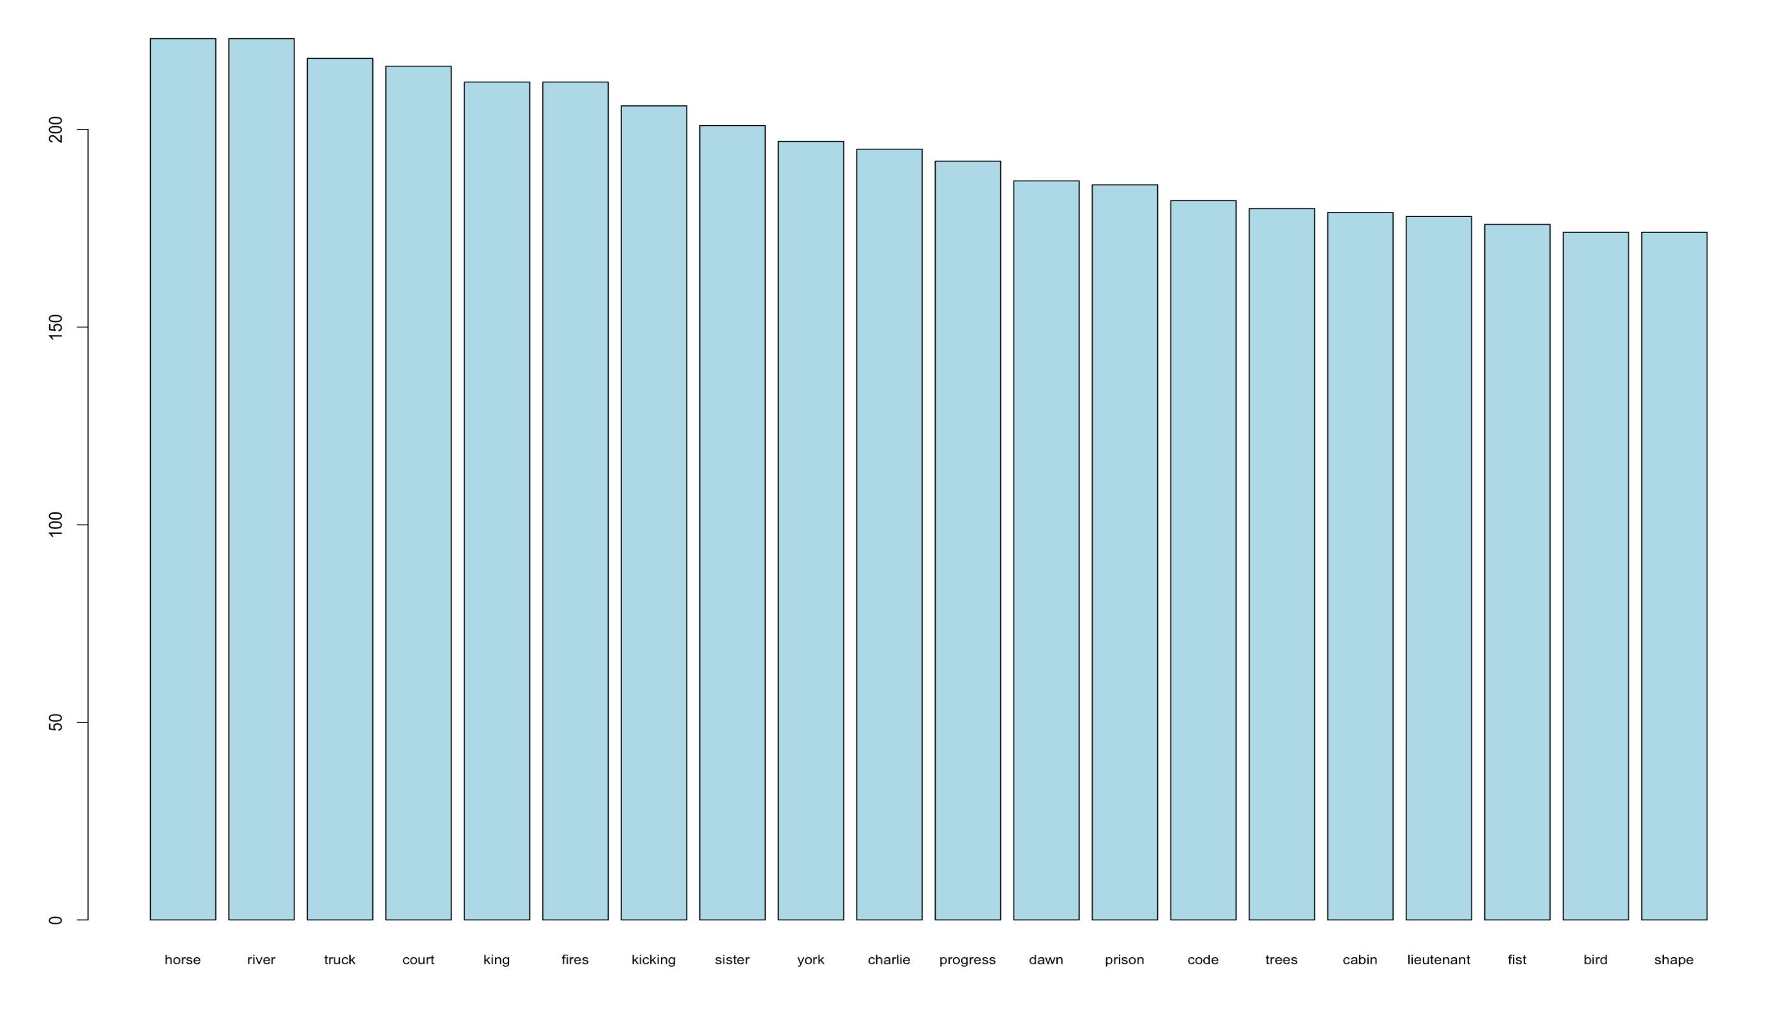
Notes:
Chosen agent: saying … you’re also likely to say agent 262

Slide 10
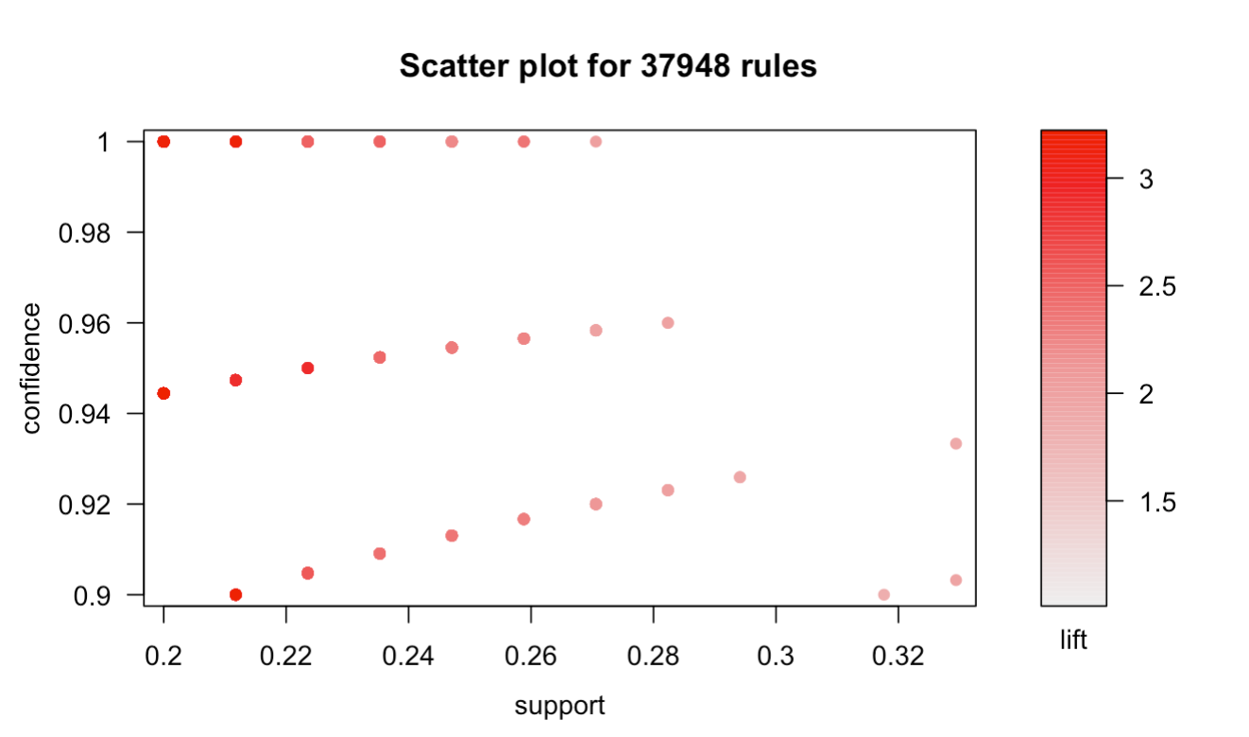
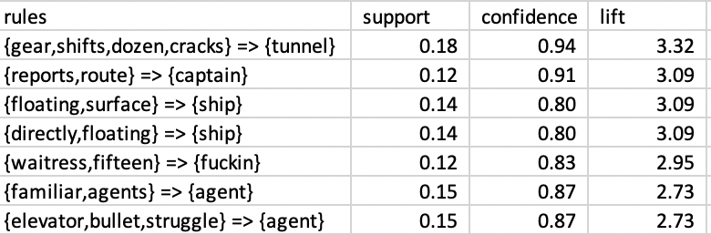
Association Rules
A lot of words were associated with “fuckin”
Waitress → Fuckin, Friday → Fuckin,
Society → Fucked, Guilty → Fucked
Other common associations
Assistant, Pockets → Elevator
Yelling → Train
Sides, Awkwardly → Dancing
Notes:
13 times likely to say agent when also saying elevator, bullet, and struggle.
Confidence: 87% of the time those words were said, so was the word agent.
2.73 there is a strong association, If Elevator, bullet, struggle are present then its about 2.5x likely to imply the presence of agent word.

Slide 11
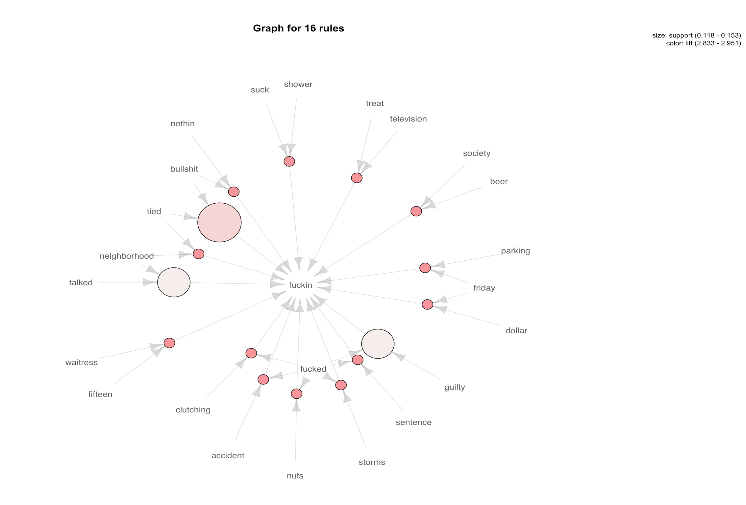

Slide 12
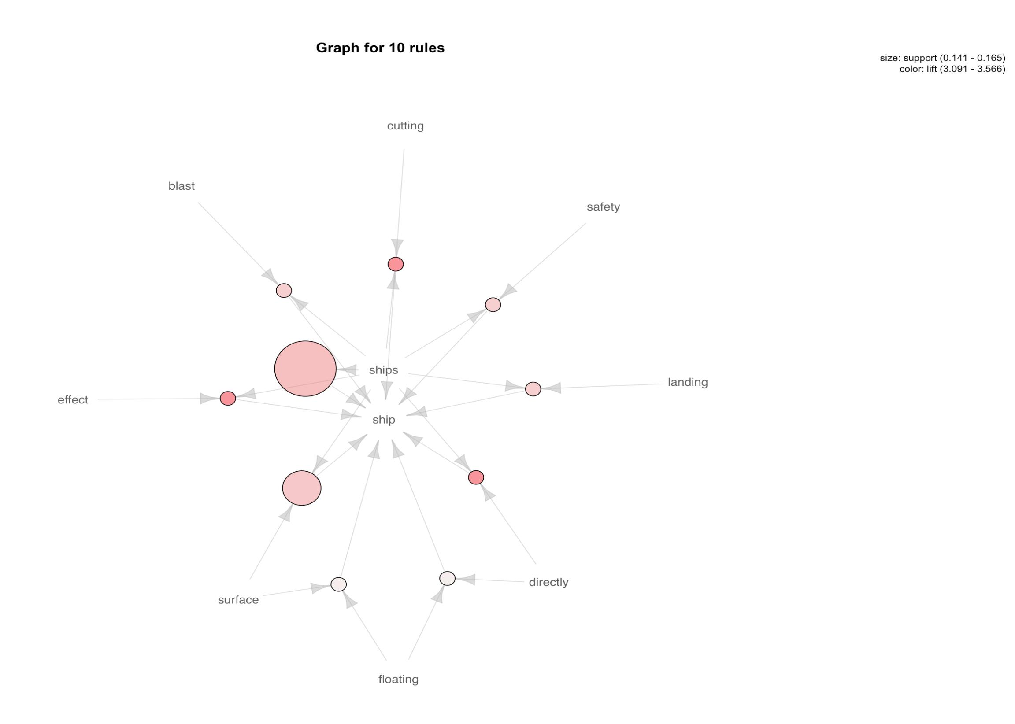

Slide 13
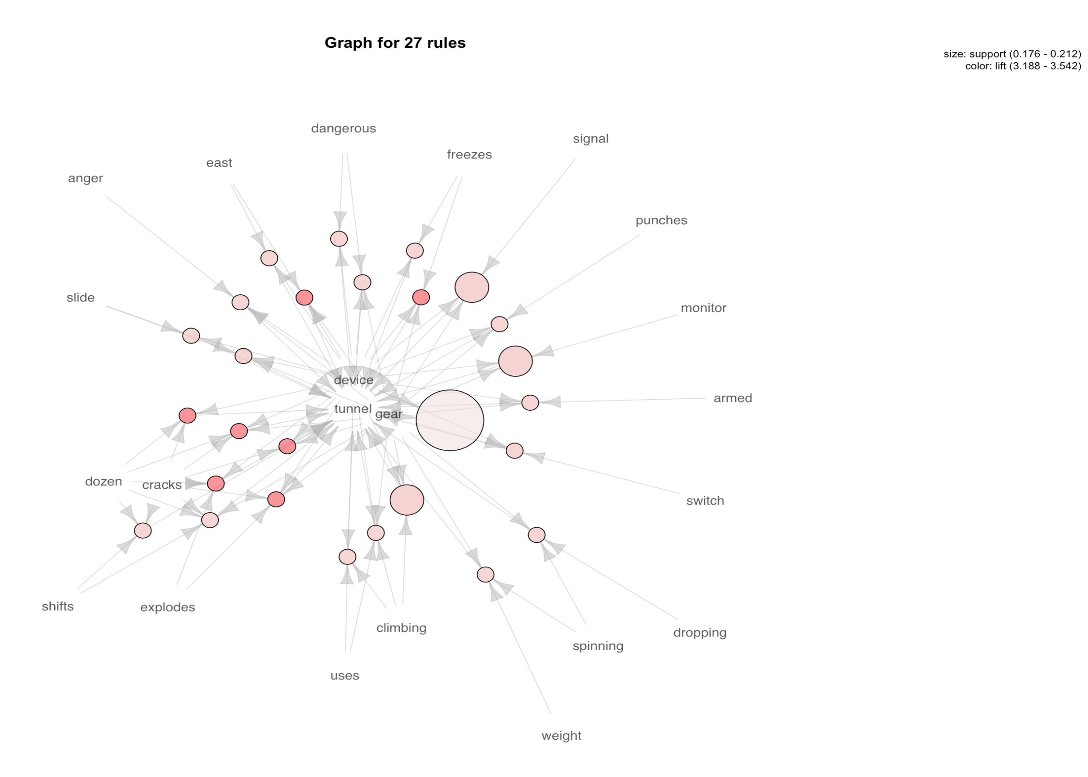
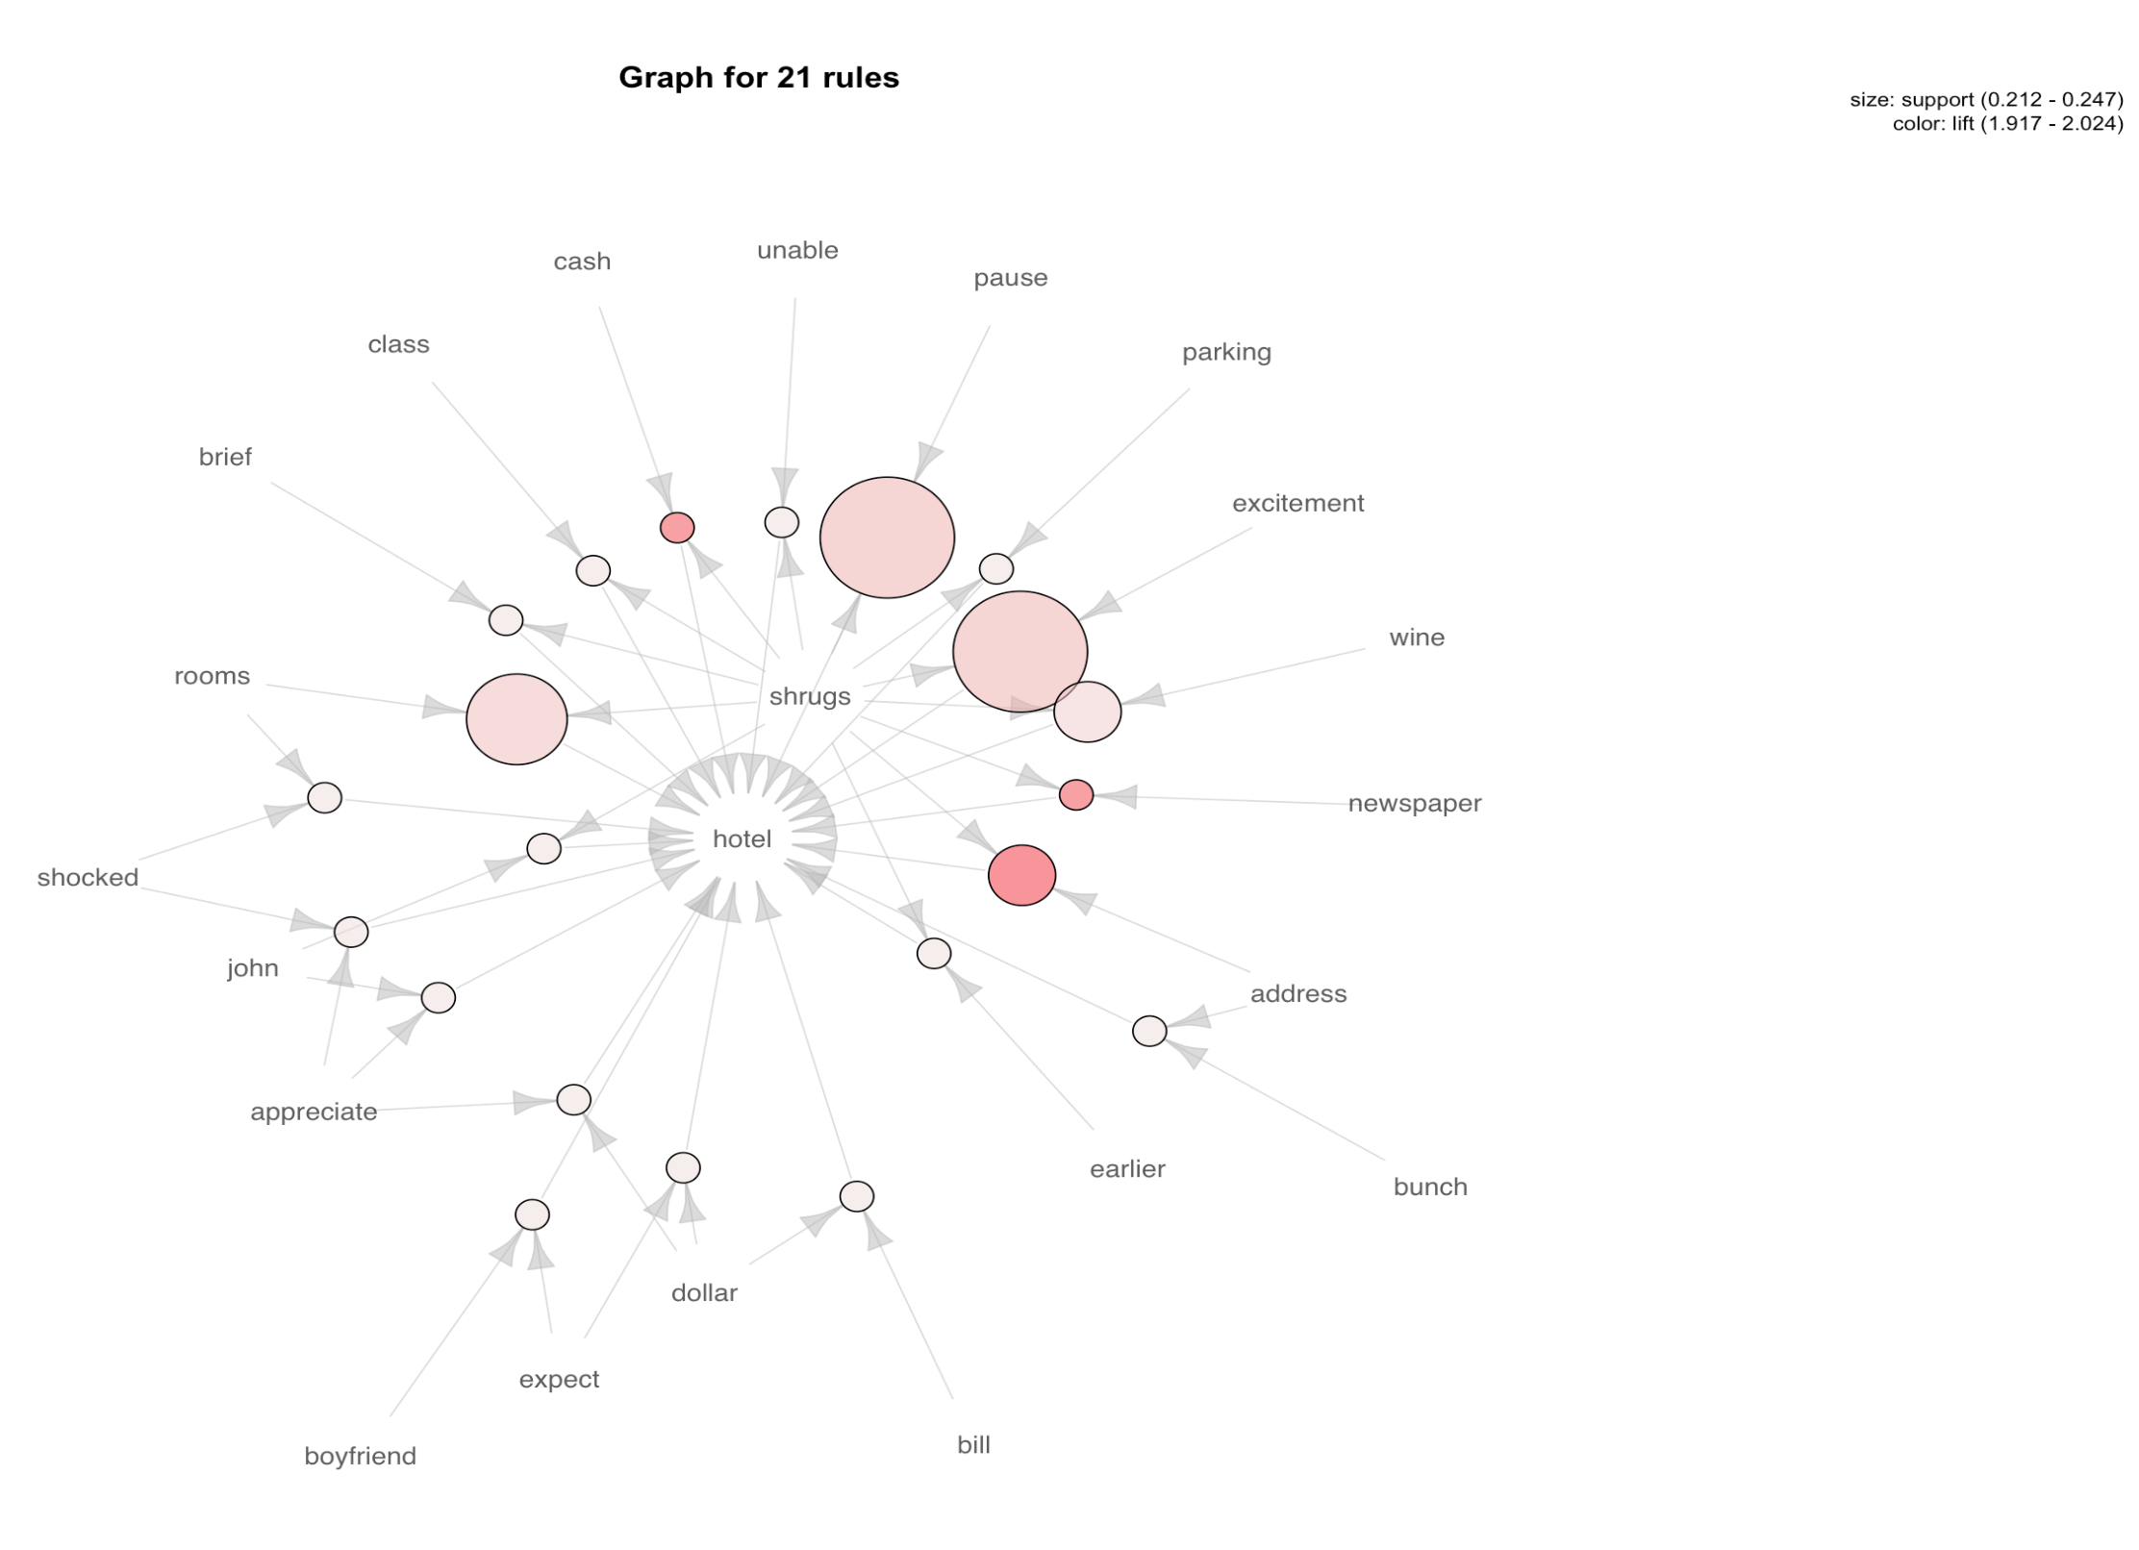

Slide 14
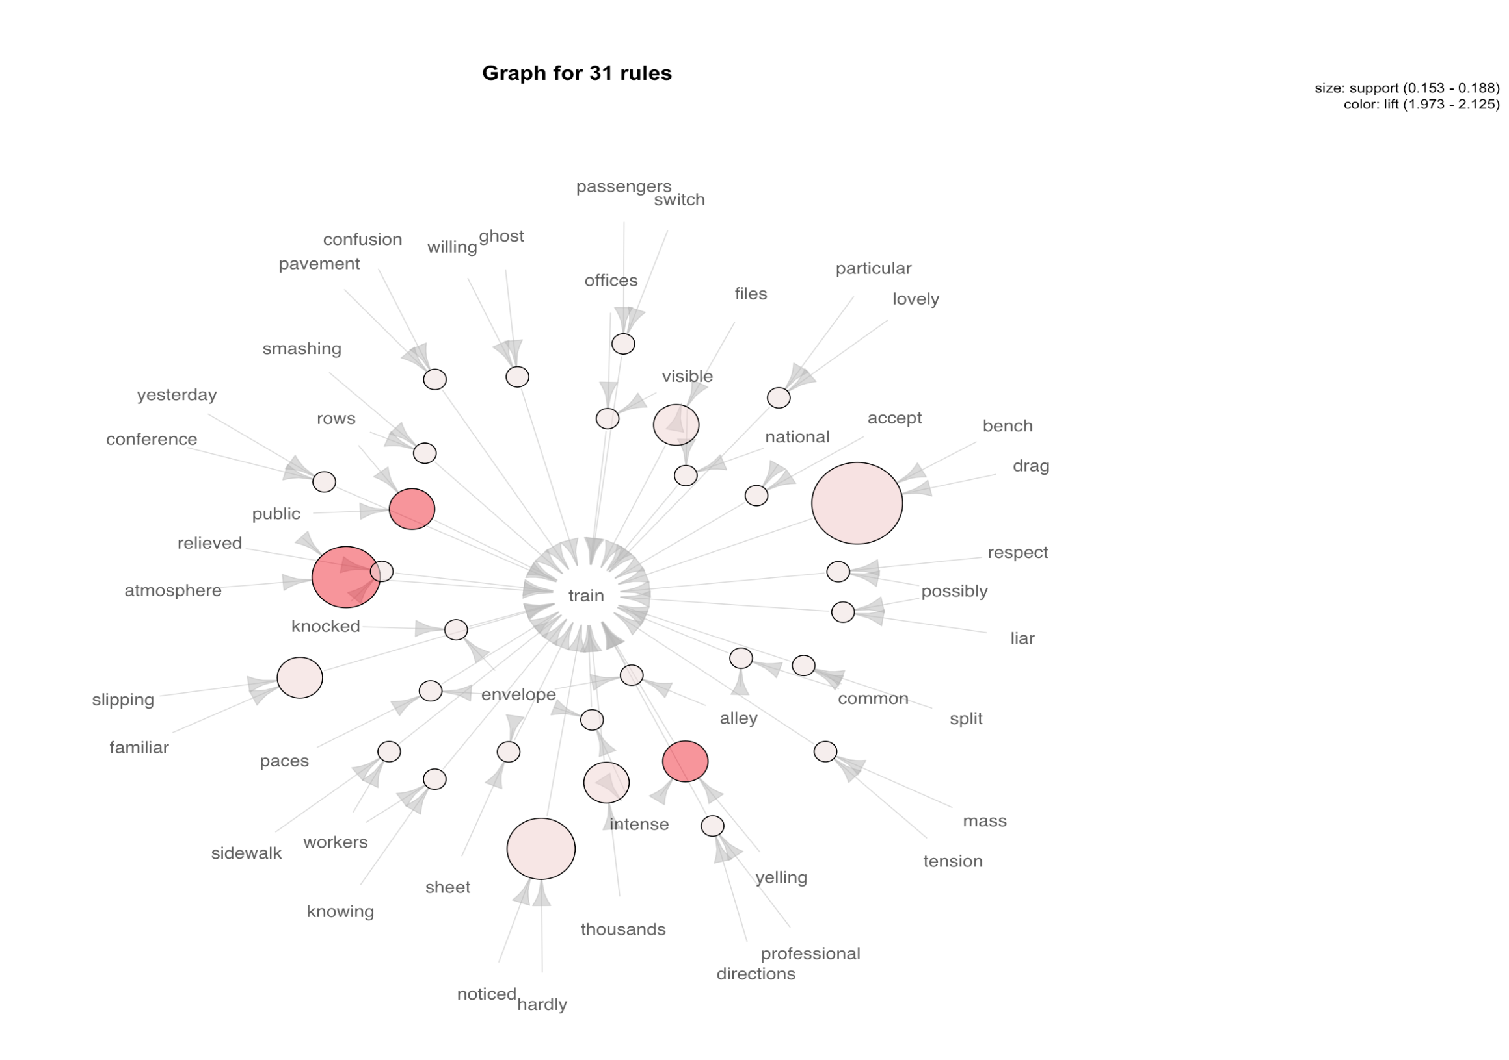
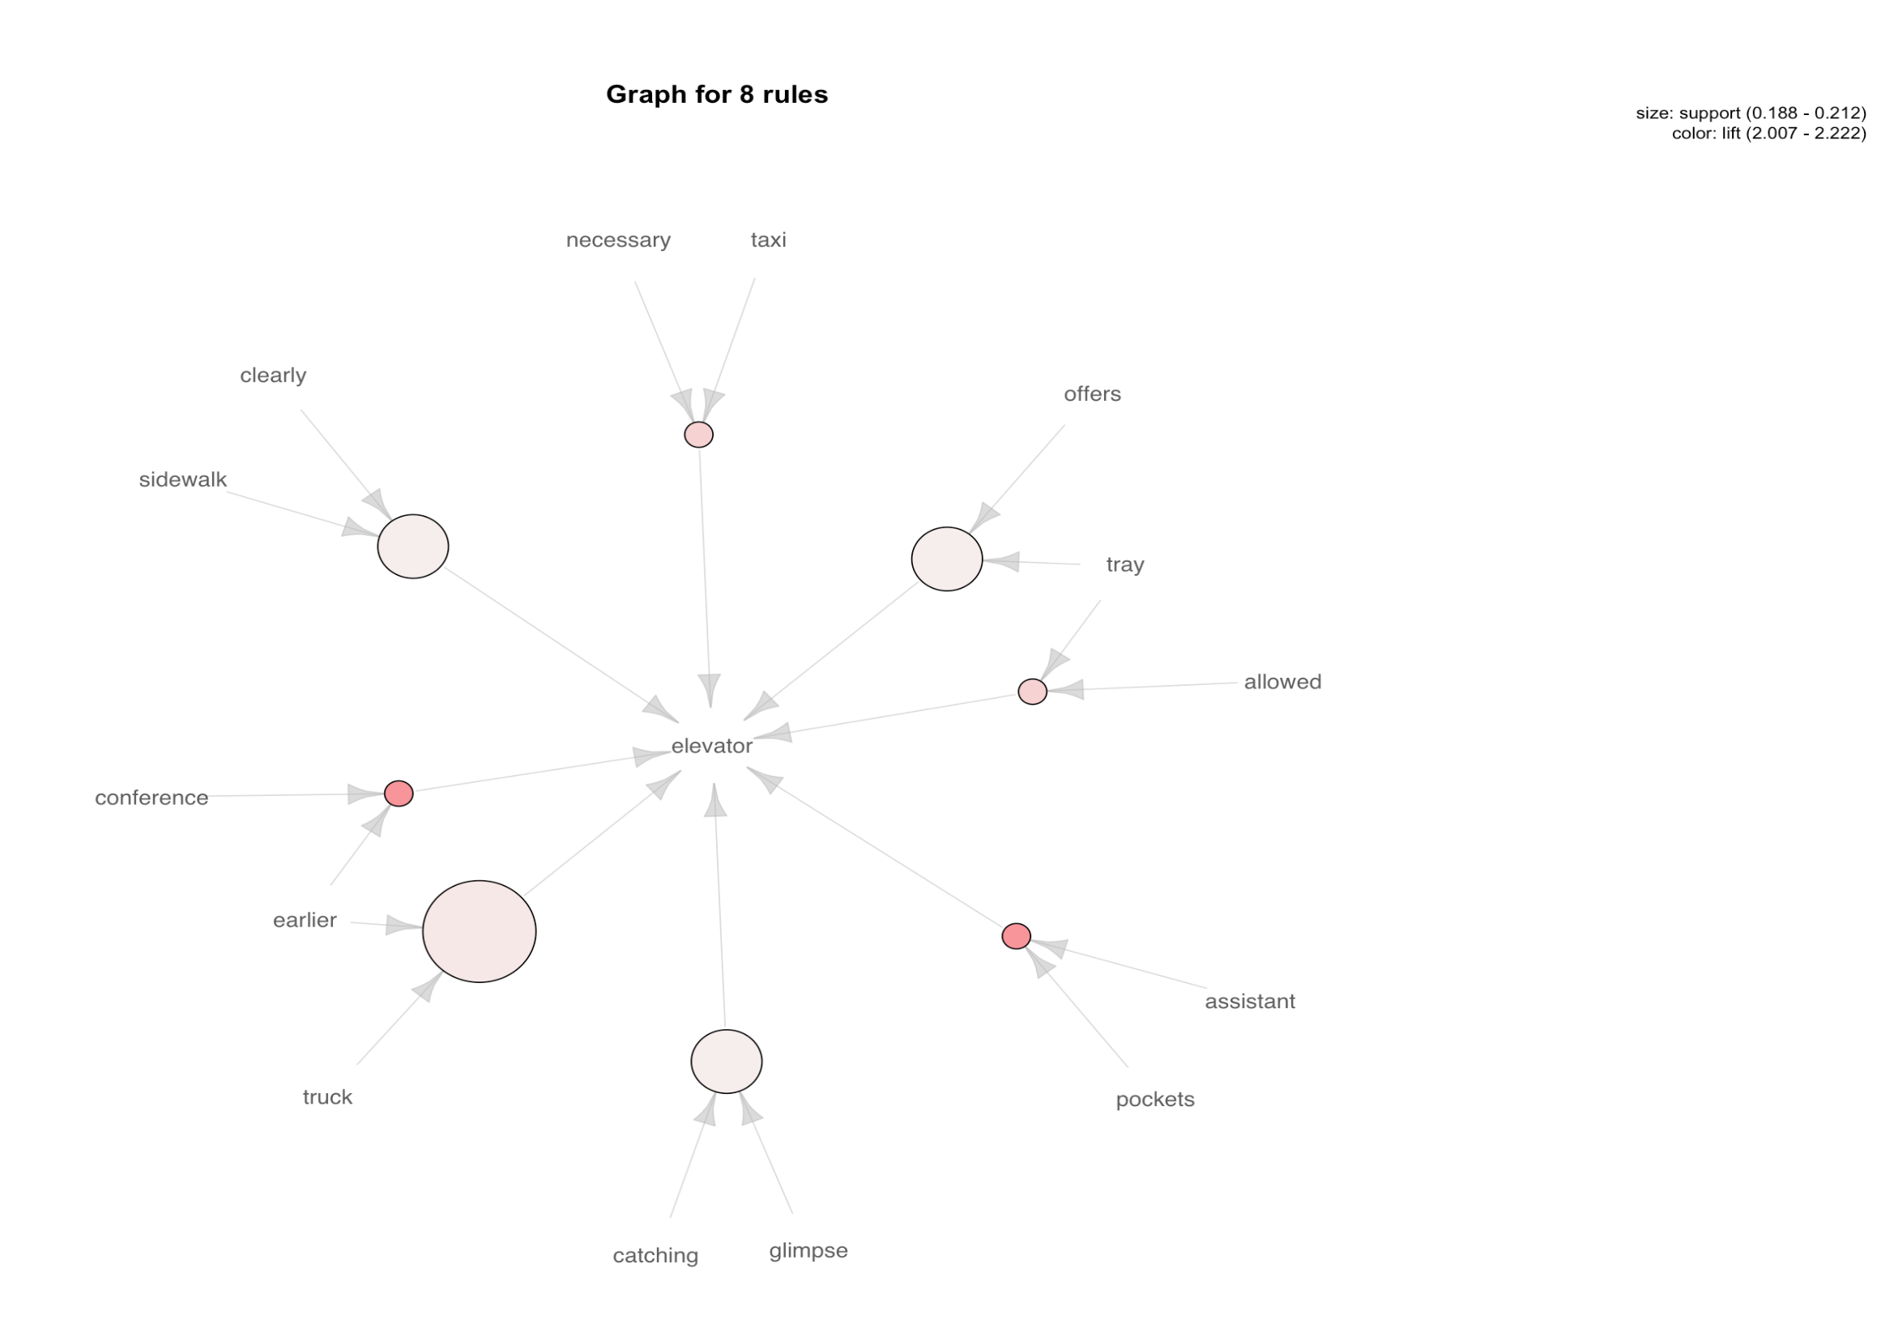

Slide 15
More Findings: Associations
Lots of words are around Hotel like
Boyfriend → Hotel
Shocked → Hotel
Lunch → Hotel
Hotel and Shrugs were strongly related
Newspaper → Hotel
Shrugs, Excitement → Newspaper

Slide 16
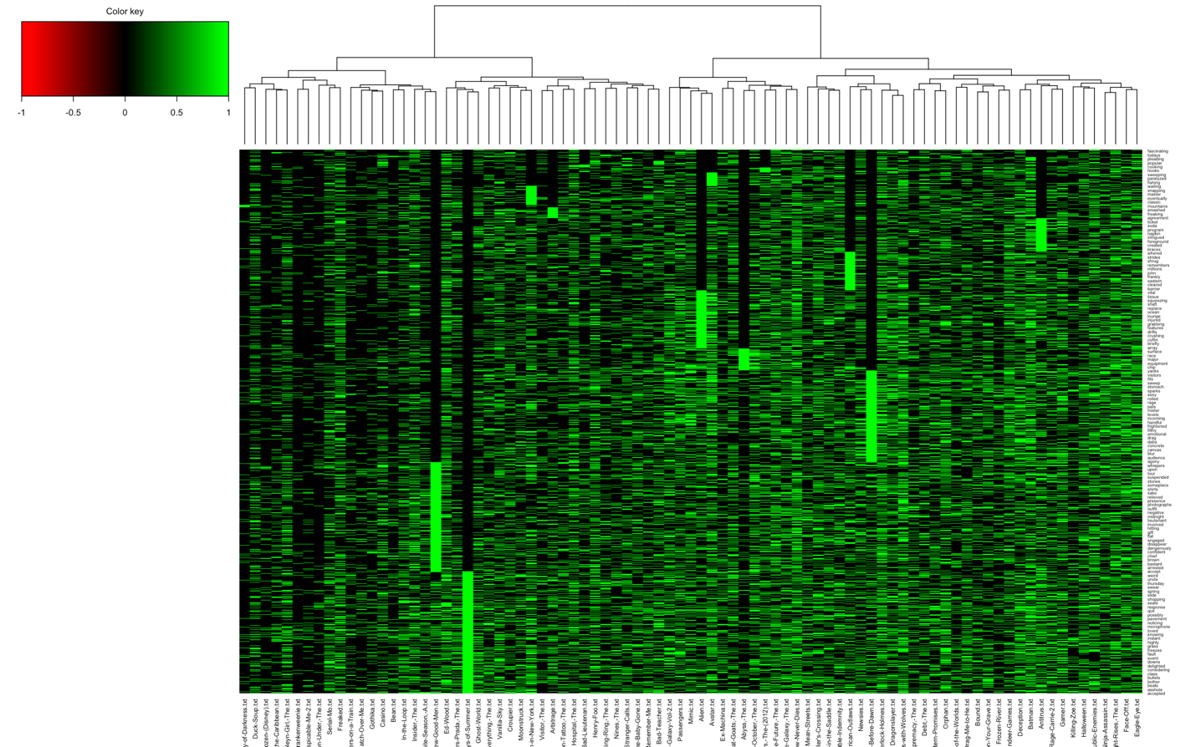
Heatmap: Only clustering movies
Chose these two movies for further sentiment analysis:
A Few Good Men
&
A Prayer Before Dawn

Slide 17

Short Story Summary
A Few Good Men
The film revolves around the court-martial of two U.S. Marines charged with the murder of a fellow Marine and the tribulations of their lawyers as they prepare a case to defend their clients.
Fun movie quote “You can’t handle the truth!”
A Prayer Before Dawn
The true story of an English boxer incarcerated in one of Thailand's most notorious prisons as he fights in Muay Thai tournaments to earn his freedom.

Slide 18
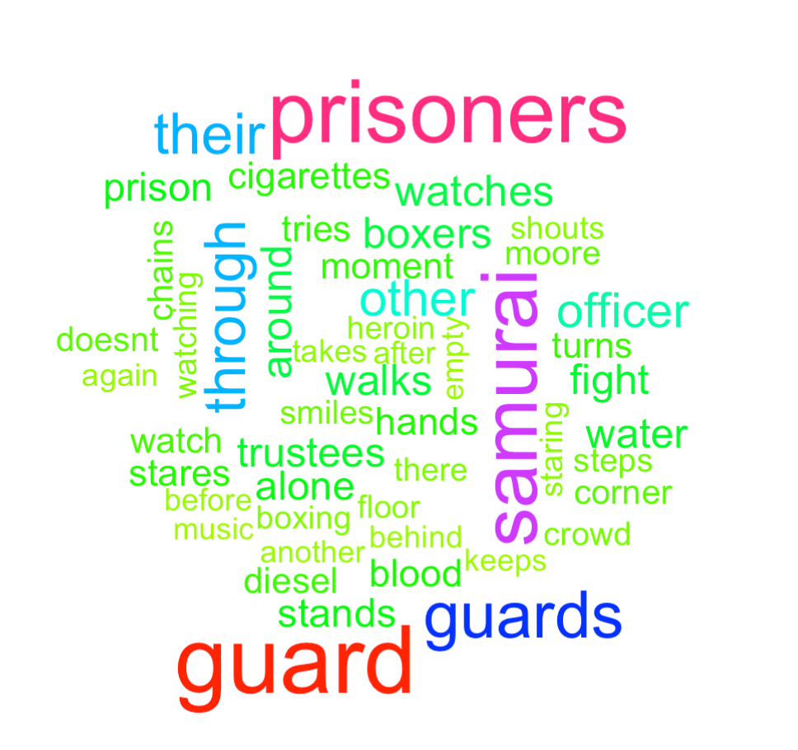
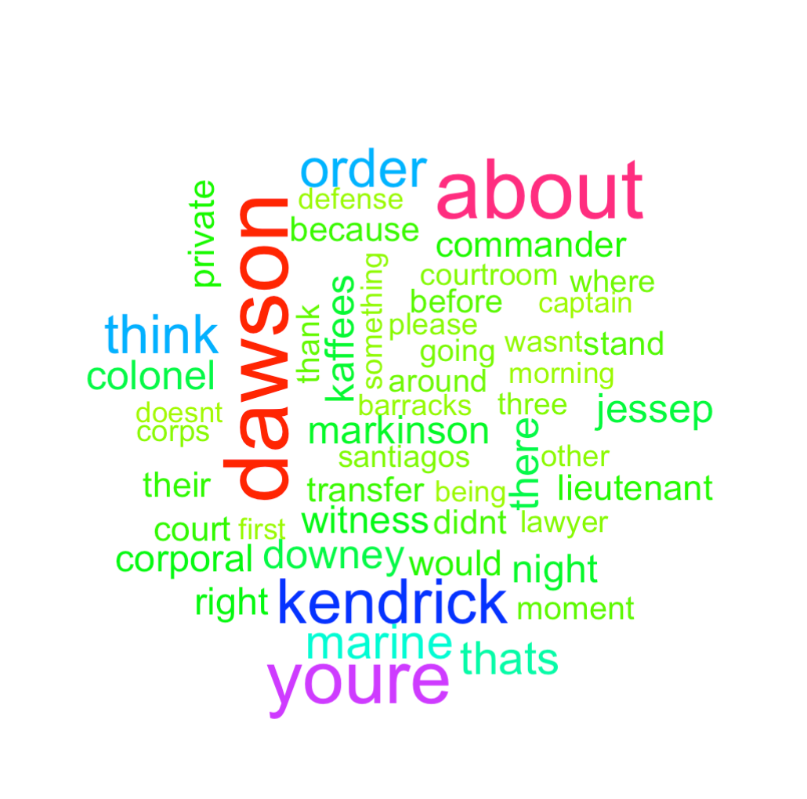
A Prayer Before Dawn
A Few Good Men

Slide 19
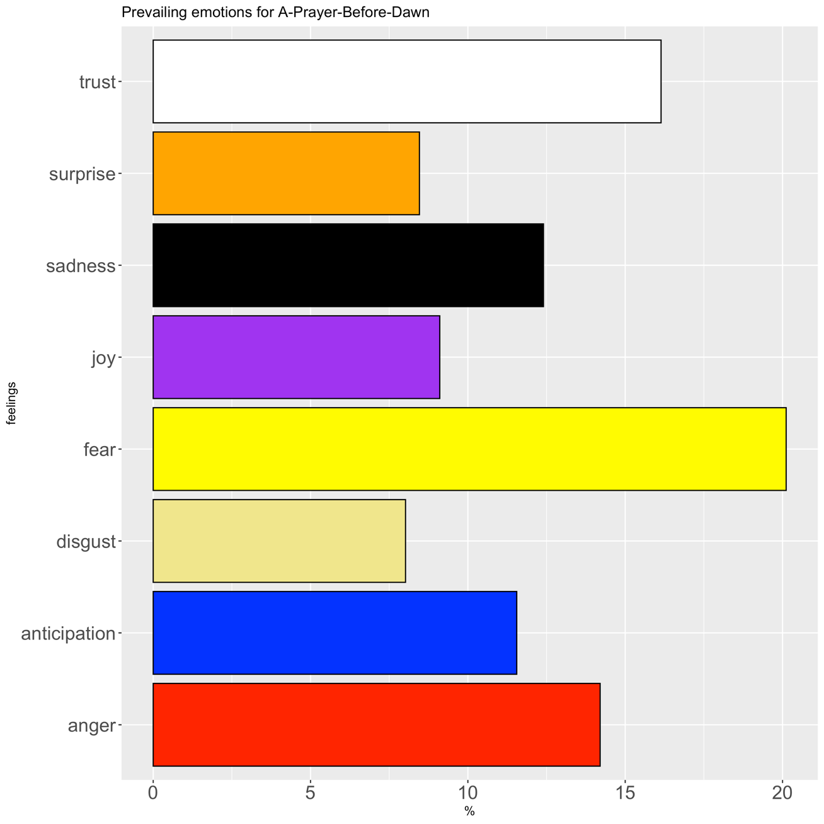
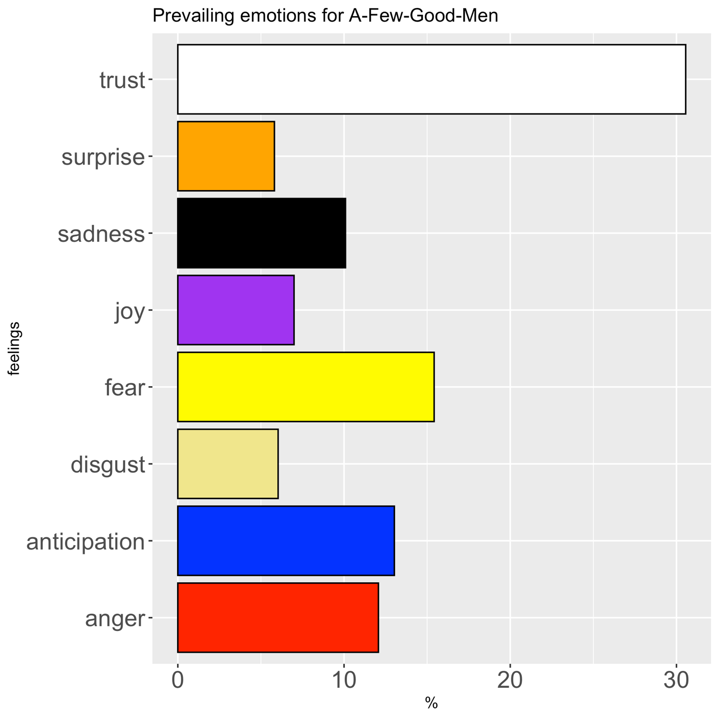
Comparing Emotional Sentiment

Slide 20
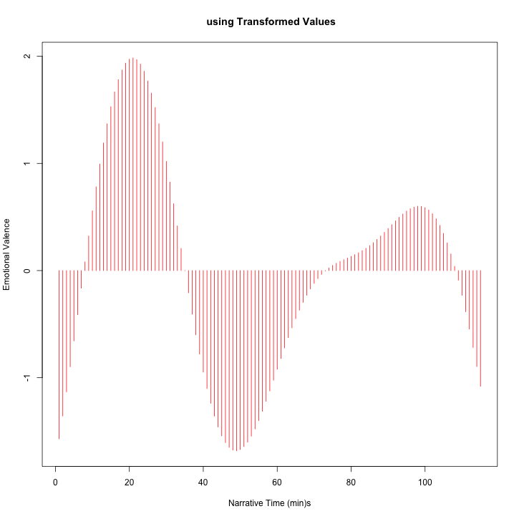
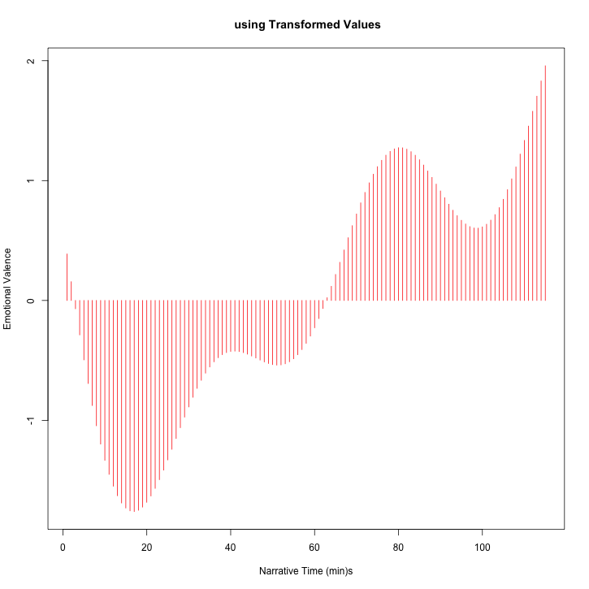
Emotional Trajectory
Above 0 → Positive Emotions
Below 0 → Negative Emotions
A Few Good Men
A Prayer Before Dawn

Slide 21

Questions?

